Slide 1
Making Decisions: the Selection Structure
Chapter 3

Slide 2
Template literals/Template strings
What are Template Literals?
Template literals, also known as template strings, are a feature introduced in ECMAScript 6 (ES6) that provide a convenient way to work with strings in JavaScript. They allow you to embed expressions within string literals, making it easier to create dynamic strings.
Advantages of Template Literals:
String interpolation: Easily embed variables and expressions within strings.
Multiline strings: Template literals can span multiple lines without the need for concatenation.

Slide 3
Syntax of Template Literals:
Template literals are enclosed in backticks (`...`) instead of single or double quotes.
const name = "Alice";
const message = `Hello, ${name}!`;

Slide 4
Variable Swapping
Variable swapping is a practical application of control structures, and it can be achieved using various techniques. Swapping variables is often necessary when reordering data or reassigning values in your programs.
There are various methods to swap two variables:
  Using a Temporary Variable
  Using Arithmetic Operations

Slide 5
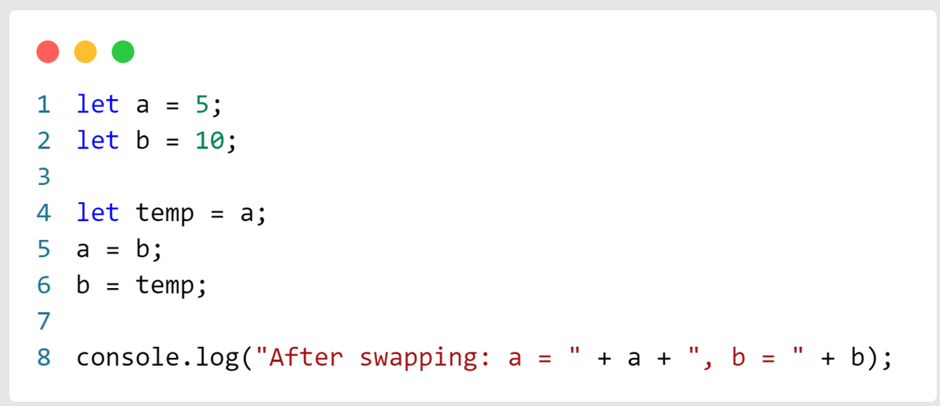
Using a Temporary Variable

Slide 6
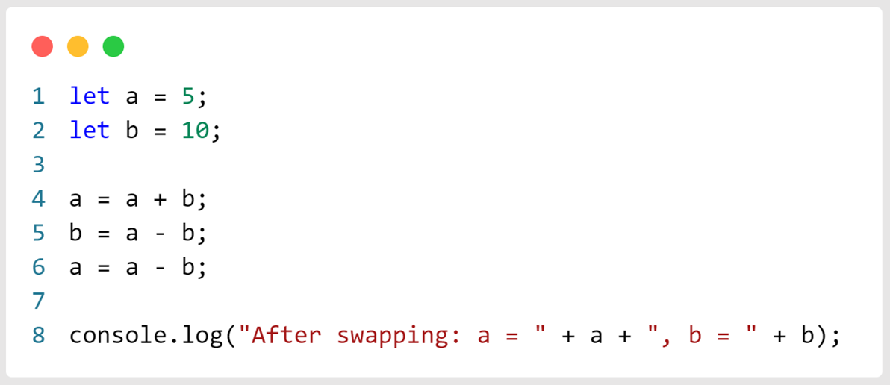
Using Arithmetic Operations

Slide 7

Selection Structures

Slide 8
Conditional Statements
Conditional statements in JavaScript are used to make decisions in your code. They allow you to execute different blocks of code based on whether a specified condition evaluates to true or false.
  Single-alternative structures
  Dual-alternative structures
  Multiple-alternative structures

Slide 9
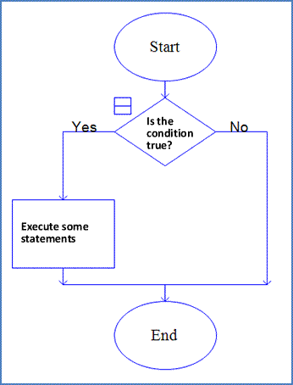
Single-alternative structures
Contains a single block of statements
If true, statements are executed
If not true, statements are skipped

Slide 10
General Format
  if (test condition)
  {
  statement;
  statement;
  .
  .
  .
  statement;
  }

Slide 11
Example: Is it snowing?
temp = prompt("What's the temperature today?", "degrees F");
if (temp < 32)
{
console.log("It may snow today!");
}
Will display only if temperature < 32⁰
Note: will not display if temperature = 32
Curly brackets { } are optional when there is only one statement in the if block

Slide 12
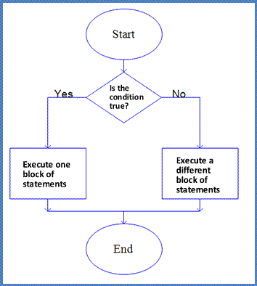
Dual-alternative structures
Contains two blocks of statements
If true, first block of statements is executed
If not true, second block of statements is executed

Slide 13
General Format
      if (test condition)
      {
      statement;
      statement;
      .
      .
      .
      statement;
      }
      else
      {
      statement;
      statement;
      .
      .
      .
      }

Slide 14
Example: Is it snowing?
temp = prompt("What's the temperature today?", "degrees F");
if (temp < 32) {
console.log("It may snow today!");
} else {
console.log("It will not snow today.");
}
  If temp < 32 → Snow message appears
  If temp >= 32 → No snow message appears (else part runs)

Slide 15
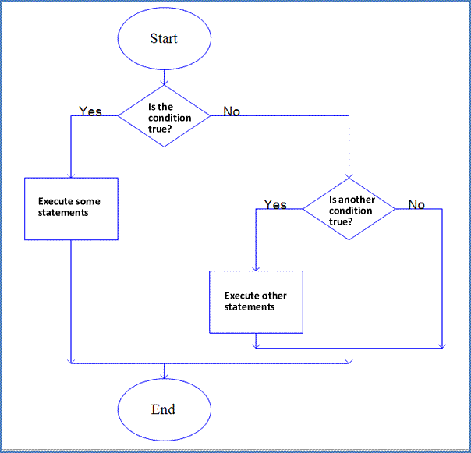
Multiple-alternative structures
Contains more than two blocks of statements
If true, first block of statements is executed
If not true, second condition is checked
If true, that block of statements is executed
If not true, another condition is checked
And so on…

Slide 16
General Format
if (test condition1)
{
if (test condition2)
{
block of statements to be executed if both condition1 and
condition2 are true;
}
else
{
block of statements to be executed if condition1 is true
but condition2 is not true;
}
}
else
{
block of statements to be executed if condition1 is false;
}

Slide 17
Example: Is it snowing?
let temp = prompt("What's the temperature today?", "degrees F");
if (temp >= 32) {
// Condition1: Is it above freezing?
if (temp < 60) {
// Condition2: Between 32 and 59
console.log("It's cool outside.");
} else {
// Condition1 true, but Condition2 false (60 or more)
console.log("The weather is warm or hot.");
}
} else {
// Condition1 false (below 32)
console.log("It may snow today!");
}

Slide 18
Compound Conditions

Slide 19
Logical Operators (revisited)
The result of an expression with logical operators is always either true or false
The AND operator is written as &&
  Always results in false unless both sides of the expression are true
The OR operators is written as ||
  Always results in true unless both sides of the expression are false
The NOT operator is written as !
  It is true if the expression is false and false if the expression is true

Slide 20
Syntax for Writing Compound Conditions
if (condition 1 && condition 2)
Must write a complete condition each time. The entire compound condition must be enclosed within the parentheses and, for each condition, the whole condition, including the variable, the relational operator, and the test, must be included.
Would not work: if (price > 5 && < 12)
Would not work: if (price > 5) && (price < 12)
Correct syntax: if (price > 5 && price < 12)

Slide 21
Using AND and OR
Most of the time either operator, so long as the conditions are written carefully, can work in a given situation.
Example: to allow only the integers 6, 7, 8, and 9 to be true:
Use the AND operator to specify that any integer greater than 5 and less than 10 is acceptable.
(num > 5 && num < 10)
This is true if num is 6, 7, 8, or 9.
Use the OR operator to specify that any integer less than or equal to 5 or greater than or equal to 10 is false. Then use the NOT operator to make it true when num is 6, 7, 8, or 9.
!(num <= 5 || num >= 10)
Both produce the same result.

Slide 22
Calculating overtime pay with the AND operator
  rate = prompt("What is the employee's pay rate?");
  hours = prompt("How many hours did the employee work this week?");
  if (hours > 40 && rate < 20) {
  overtime = rate * 1.5 * (hours - 40);
  regular = rate * 40;
  pay = overtime + regular;
  } else {
  pay = rate * hours;
  }
  console.log("Your paycheck this week will be $ " + pay);

Slide 23
Calculating overtime pay with the OR operator
  rate = prompt("What is the employee's pay rate");
  hours = prompt("How many hours did the employee work this week?");
  if (hours <= 40 || rate >= 20) {
  pay = rate * hours;
  } else {
  overtime = rate * 1.5 * (hours - 40);
  regular = rate * 40;
  pay = overtime + regular;
  }
  console.log("Your paycheck this week will be $ " + pay);

Slide 24
Multiple-Alternative Selection Structures

Slide 25
General Format:
The if...else if... Structure
  if (test condition 1)
  {
  statements to be executed;
  }
  else if (test condition 2)
  {
  statements to be executed;
  }
  else
  {
  statements to be executed if neither condition
  1 nor condition 2 are true;
  }

Slide 26
Example: A Rating System Using the if...else if... Structure
rate = prompt("Rate the site from 1 to 10,
with 10 as the best"," ");
grade = " "
if (rate == 10)
grade = "A";
else if (rate >= 7 && rate <= 9)
grade = "B";
else if (rate >= 4 && rate < 7)
grade = "C";
else
grade = "D";
console.log(“You gave the site a rating of " +
grade “)

Slide 27
General Format:
The switch Structure
switch(test expression)
{
case 1:
execute code block 1
break;
case 2:
execute code block 2
break;
.
...all other cases and code to be executed
.
case n:
execute code block n
break;
default:
code to be executed is nothing matches the test condition
}

Slide 28
Example: A Rating System Using the switch Structure
let day =prompt("Enter number(“1 = Monday,7= Sunday):");
switch (day) {
case 1:
console.log("Monday is a Weekday.");
break;
case 2:
console.log("Tuesday is a Weekday.");
break;
case 3:
console.log("Wednesday is a Weekday.");
break;
case 4:
console.log("Thursday is a Weekday."); break;
case 5:
console.log("Friday is a Weekday.");
break;
case 6:
console.log("Saturday is a Weekend.");
break;
case 7:
console.log("Sunday is a Weekend.");
break;
default:
console.log("Invalid number! Please enter 1–7.");
}

Slide 29
Notes re: the switch Structure
Without the break statement, all following cases will execute!
color =prompt(“Enter 1 for red, 2 for
blue, 3 for yellow"," ");
switch (color)
{
case 1:
console.log(“ the color is red”);
case 2:
console.log(“ the color is blue”);
case 3:
console.log(“ the color is green”);
default:
console.log(“ invalid entry ”);
}

Slide 30
Results
Entering a 1 will result in:
You like red.
You like blue.
You like yellow.
Invalid entry
Entering a 2 will result in:
You like blue.
You like yellow.
Invalid entry
Entering a 3 will result in:
You like yellow.
Invalid entry
Entering anything else will result in:
Invalid entry

